Slide 1

DWIHN HEDIS MEASURES Definitions and Goals

Slide 2
What is HEDIS?
The Healthcare Effectiveness Data and Information Set (HEDIS®) is a set of performance data developed and maintained by the National Committee for Quality Assurance (NCQA), and is the most widely used standardized performance measure in the managed care industry. HEDIS is part of an integrated system to establish accountability in managed care.
Behavioral health has multiple measures that include ensuring continuity of care, for example; appropriate psychotropic medication management/adherence, follow up after hospitalization, and diabetes monitoring. Detroit-Wayne Integrated Health Network collects HEDIS data to measure and improve the quality of care that the members receive

Slide 3
What is in DWIHN HEDIS SCORECARD?
The HEDIS Quality Scorecard includes 15 HEDIS measures and 1 custom measure (UAM45).
HEDIS Quality Scorecard includes DWIHN total score, CRSP Total score, members included in score and if they met the measure.
All data can be exported to an excel or PDF document.
HP Goal based on State goals based on 95% of all Health Plans.

Slide 4
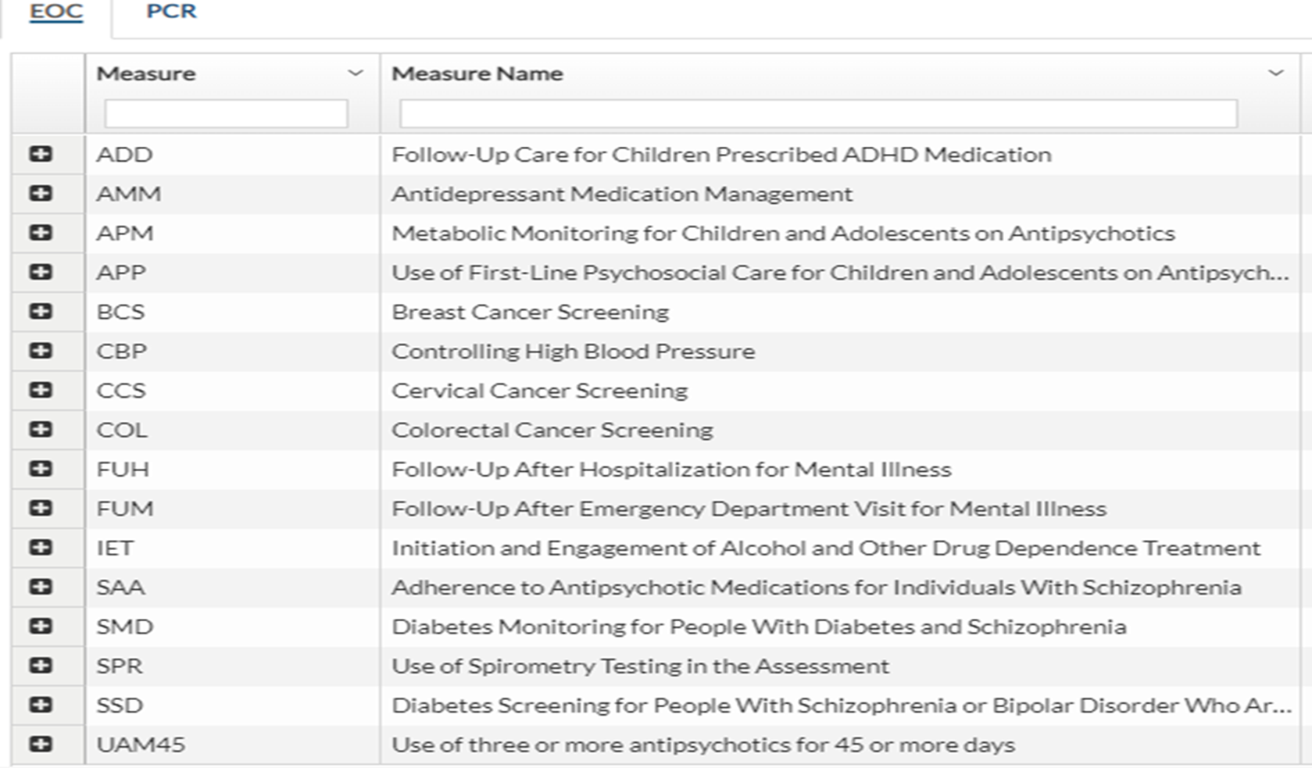
What are the HEDIS Measures?

Slide 5
Key performance HEDIS measures that are monitored by the State of Michigan and Health Plans. (Incudes definition)
Follow Up after hospitalization (FUH) State goal for PIHP’S is 70% for children and 58% for Adults. This is a pay for performance measure. Follow up with a clinician/doctor 7 and 30 days of discharge from hospital.
Follow up after Ed visit for mental health (FUM) Goal for 30 day ages 6-17 yr is 84.33%, ages 18-62 is 61.05%. 7 day follow up ages 6-17yrs 73.13% and 18-64 is 47.07%. Assesses emergency department (ED) visits for adults and children 6 years of age and older with a diagnosis of mental illness or intentional self-harm and who received a follow-up visit for mental illness within 7 or 30 day by a clinician/doctor.
Adherence to Antipsychotic medication for individuals with Schizophrenia (SAA)Goal 85.09%. Diagnosis of schizophrenia or schizoaffective who were dispensed and refilled at least 80% of the time.
Antidepressant medication management (AMM) Goal 37% for acute phase and 63.41 for continuation phase. Adults 18 years of age and older with a diagnosis of major depression who were newly treated with antidepressant medication and remained on their antidepressant medications

Slide 6
Continue.
Follow up care for children prescribed (ADHD) medication (ADD).
Initiation Phase: Assesses children between 6 and 12 years of age who were diagnosed with ADHD and had one follow-up visit with a practitioner with prescribing authority within 30 days of their first prescription of ADHD medication. Goal is 46.1%
Continuation and Maintenance Phase: Assesses children between 6 and 12 years of age who had a prescription for ADHD medication and remained on the medication for at least 210 days, and had at least two follow-up visits with a practitioner in the 9 months after the Initiation. Goal 62.04%
Diabetes screening for people with schizophrenia or bipolar disorder who are using an antipsychotic (SDD) Goal is 86.36%. Adults 18–64 years of age with schizophrenia or bipolar disorder, who were dispensed an antipsychotic medication and had a diabetes screening test during the measurement year.
Metabolic monitoring for children and adolescents on antipsychotics (APM). Percentage of children and adolescents with ongoing antipsychotic medication use who had metabolic testing during the year. Goal for Blood Glucose and Cholesterol ages 1-11, 23.36%, ages 12-17, 29.23%

Slide 7
Measures that will be monitored by only DWIHN
Use of First-Line Psychosocial Care for Children and Adolescents on Antipsychotics (APP). Percentage of children and adolescents newly started on antipsychotic medications without a clinical indication who had documentation of psychosocial care as first-line treatment. Goal ages 1-11, 67.39%, ages 12-17, 75.54%.
Diabetes Monitoring for People With Diabetes and Schizophrenia (SMD). Diabetes screening in the past year. Goal 85.71%%
Use of three or More Antipsychotics for 45 or More Days (UAM45). For this measure the lower the number for goal the better. Goal less than 10%
Initiation and Engagement of Alcohol and Other Drug Dependence Treatment (IET). This measure is not created yet due to HIPPA and SUD information.

Slide 8
Health HEDIS Measures that are helpful for integration of care. These measures are information only, CRSP’s can use this to see if a member has had certain medical screenings in the calendar year
These measures are information only, CRSP’s can use this to see if a member has had certain medical screenings in the calendar year
Breast Cancer Screening (BCS). Assess women from 50-74 years who had at least one mammogram screening in the past 2 years.
Controlling High Blood Pressure (CBP). Assesses patients (18–85 years of age) who had a diagnosis of hypertension reported on an outpatient claim and blood pressure adequately controlled
Cervical Cancer Screening (CCS). Assesses women who were screened for cervical cancer using any of the following criteria:
Women 21–64 years of age who had cervical cytology performed within the last 3 years.
Women 30–64 years of age who had cervical high-risk human papillomavirus (hrHPV) testing performed within the last 5 years.
Women 30–64 years of age who had cervical cytology/high-risk human papillomavirus (hrHPV) cotesting within the last 5 years

Slide 9
Continue
Colorectal Cancer Screening (COL). Assesses adults 50–75 who had appropriate screening for colorectal cancer with any of the following tests: annual fecal occult blood test, flexible sigmoidoscopy every 5 years, colonoscopy every 10 years, computed tomography colonography every 5 years, stool DNA test every 3 years
Use of Spirometry Testing in the Assessment (SPR). Assesses adults 40 years of age and older who have a new diagnosis of chronic obstructive pulmonary disease (COPD) or newly active COPD, who received spirometry testing to confirm the diagnosis

